Slide 1

Children and Mental Health
Presented by:
Dr. Lorraine Giardino
Dr. Sharon Kochlany
Moderated by: Roxie Cohen
02/24/22

Slide 2

Manifestations of Mental Health Issues:
Problems in behavioral and/or emotional regulation are most frequently observed.
Escalating behaviors that violated the rights of others or bring the child into significant conflict with familial, educational, societal or authoritative figures.

Slide 3

The Pandemic:
Lockdowns
Masks
Social Distancing
Isolation
Joblessness
Loss of Business
School Closings
Childcare
Online learning

Slide 4

Stress:
Not all children react to stress in the same way
  Childhood stress can be present in any setting that requires the child to adapt to change
  The changes can be both positive and negative
  Children often learn how to deal with stress, in part, by what they see and feel in their environment

Slide 5

Distress Symptoms:
Infants – may become cranky and want to be held
3-6 year old preschool and kindergarten may return to previously mastered behavior in speech and toileting
7-10 year-olds may become withdrawn or overactive. Problems with concentration may present academic concerns
Preteen – Teenager may respond by acting out, curfew infractions, substance abuse, reckless behaviors. Some may become frightened of leaving the home. They may feel fearful or facial disaster or illness
95% of college students say their mental health has declined

Slide 6
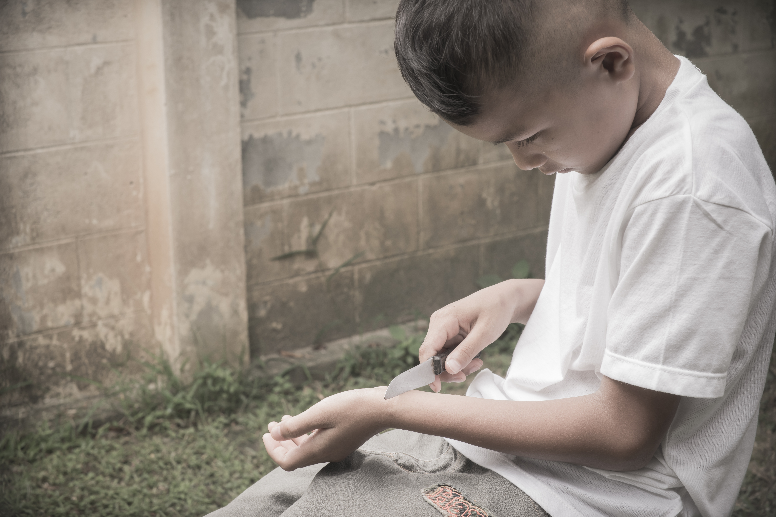
Distress Symptoms:
Special Needs Children– May experience more intense distress worry, or anger, because they have less
control over day-to-day wellbeing
Nausea
Cutting

Slide 7

Common Causes of Stress Include, But Are Not Limited To:
Negative thoughts about themselves
Changes in familial make-up, school, or housing
Juggling familial, social, and academic expectations
Peer pressure
Body Changes

Slide 8
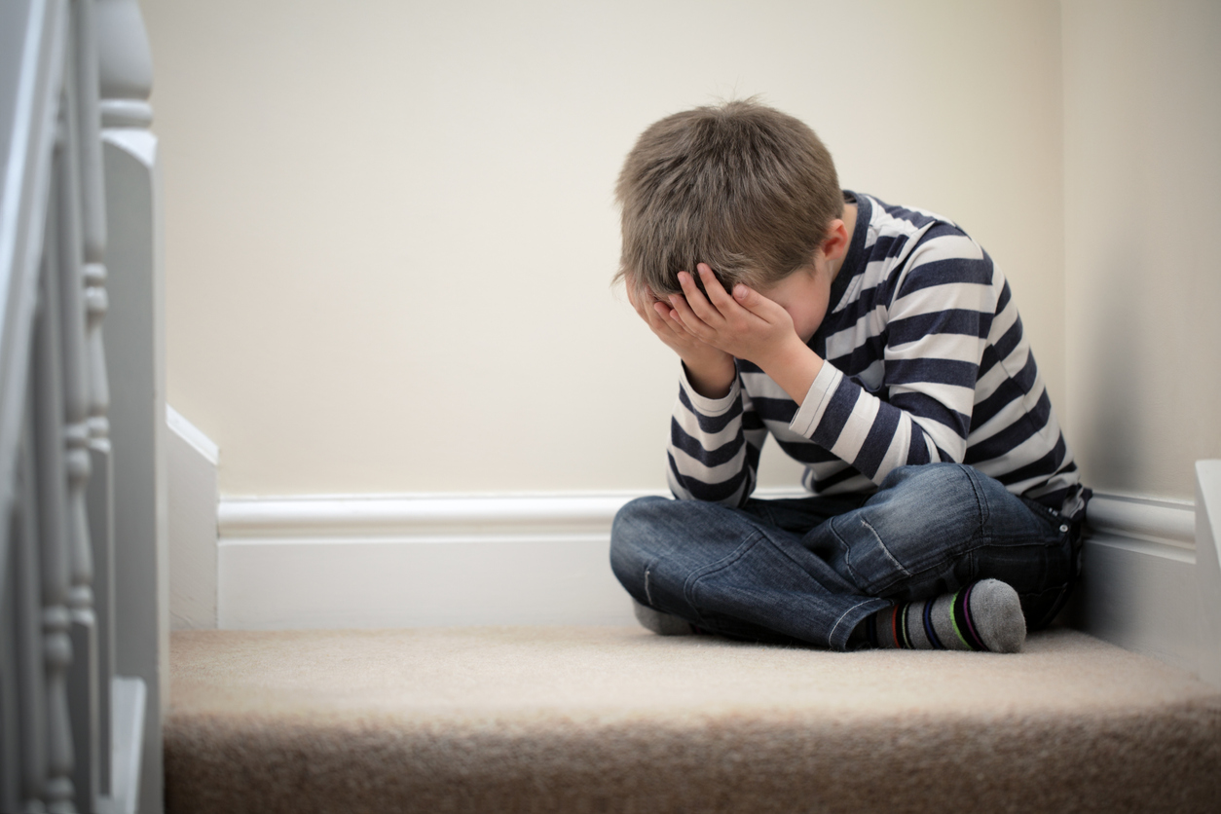
Common Indicators Include, But Are Not Limited To:
Trembling
Rapid heartbeat
Sweating
Dizziness
Extensive worrying and overthinking
Extreme embarrassment
Full blown panic attacks

Slide 9

Common Indicators Include, But Are Not Limited To:
Unexplained pain
New or recurring fears
Inability to stay on task
Destruction of property
Anger outbursts

Slide 10
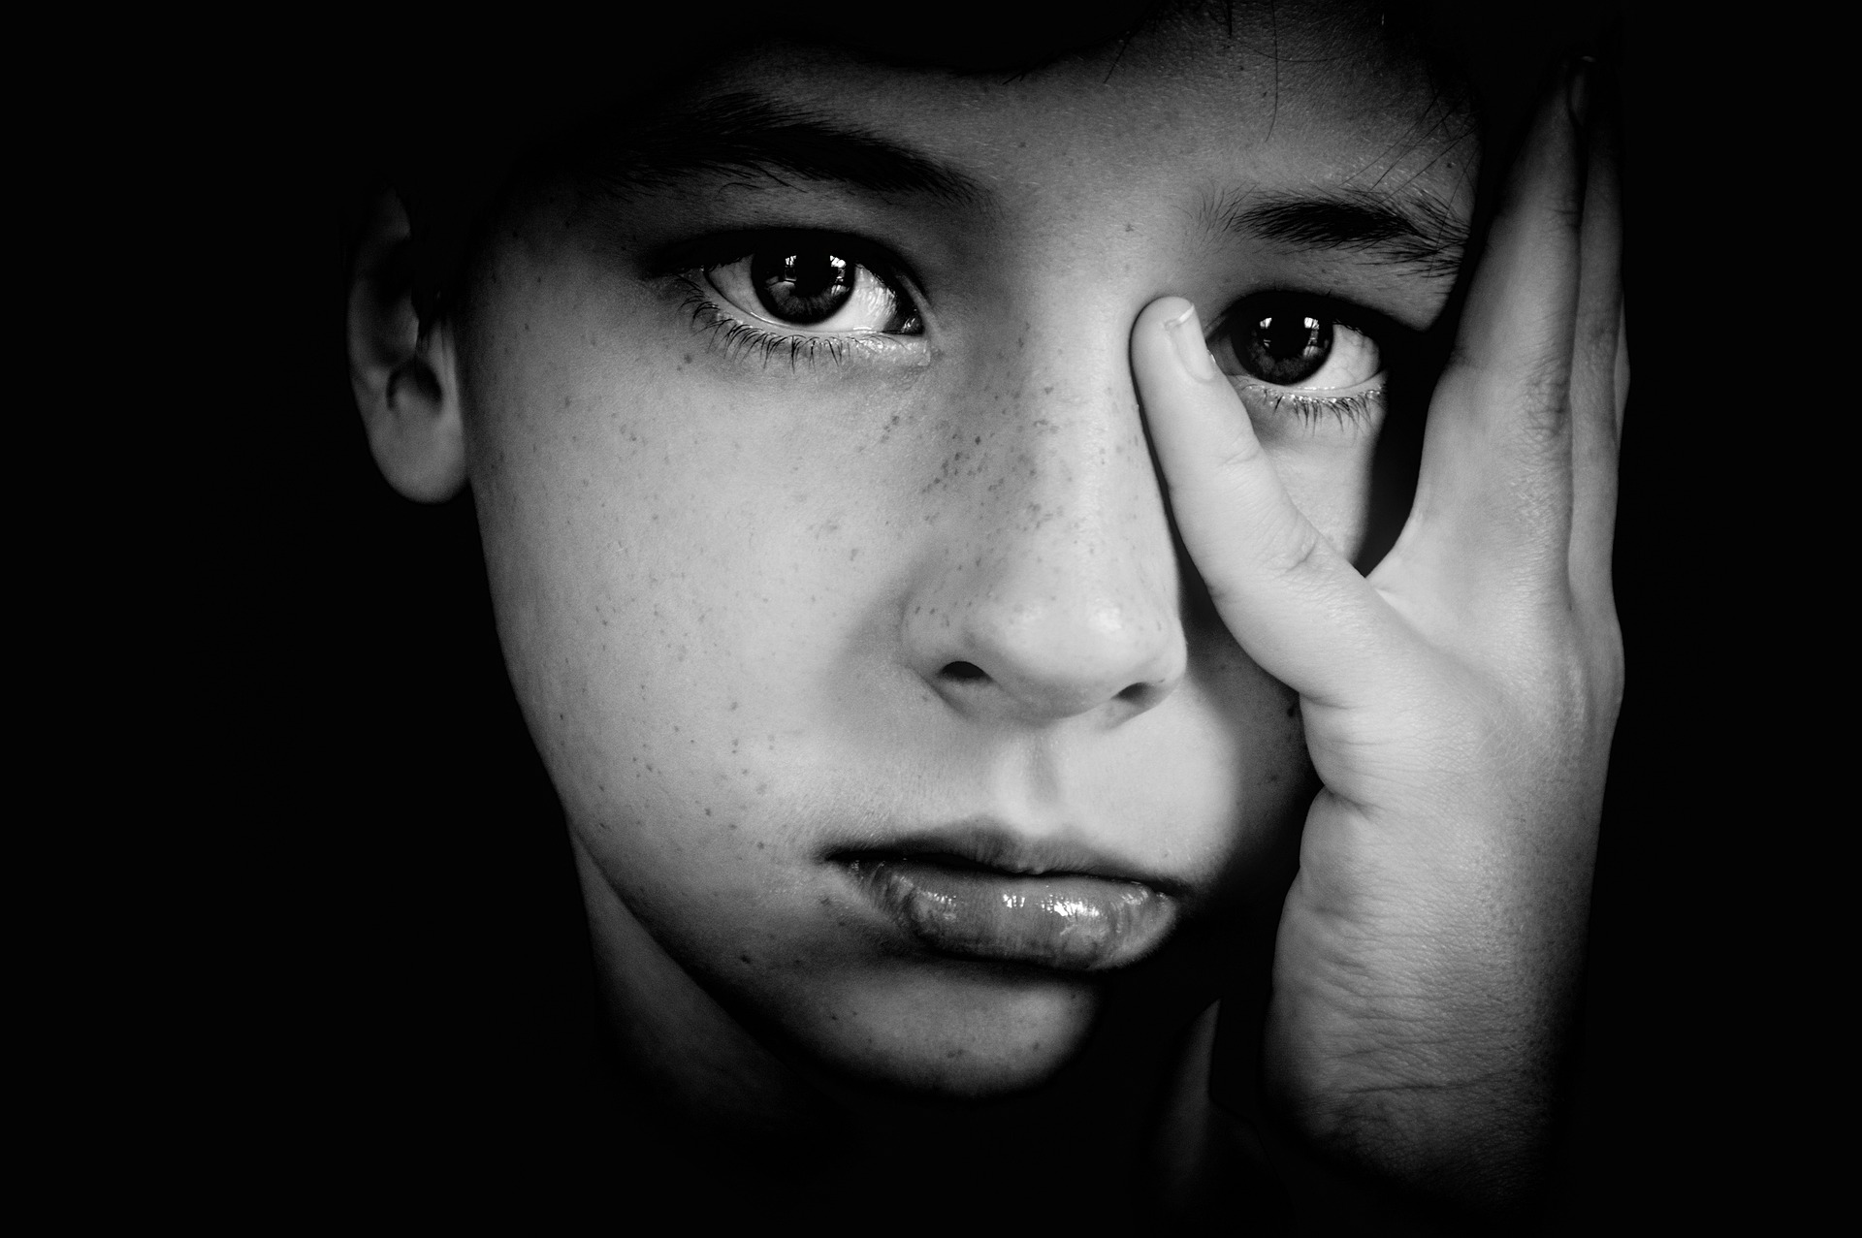
Common Indicators Include, But Are Not Limited To:
Increased alcohol and cannabis use
Survey from 2020 revealed:
  38% were feeling tired
  36% sleep disturbances
  In December, 42% reported symptoms of anxiety or depression that month, an increase from 11% the year before
  An MNT study found that cases of depression has tripled.

Slide 11

Stats:
CDC study showed that one in four 18 – 24 year-olds said that they’ve thought about self harm during the pandemic
More than 50% reported at least one negative mental health symptom
Children and adolescents are the largest population of internet porn viewers
Sexting, sharing illicit pictures and videos and cyberbullying may become methods of manipulation

Slide 12

Stats:
Studies show that 93% of boys and 62% of girls have seen or had contact with pornography by the time they are 18
The average age for pornographic trafficking is between 12 and 14 years
The world has changed forever. Easy access to information has presented a problem that can be harmful to children. Children often do not make safe decisions and frequently become victims, either by mistake or because their brains are not capable of evaluating the consequences
This fact makes it easy for children to become targets of sexual victimization.

Slide 13

How The Pandemic Has Affected Our Children in School:
Diagnosis of depression and anxiety increase with age while behavior problems are most often seen among children 6 - 11
Manifestations
  Tired
  Withdrawal from friends and usual activities
  Irritability
  Aggressiveness
  Sadness

Slide 14
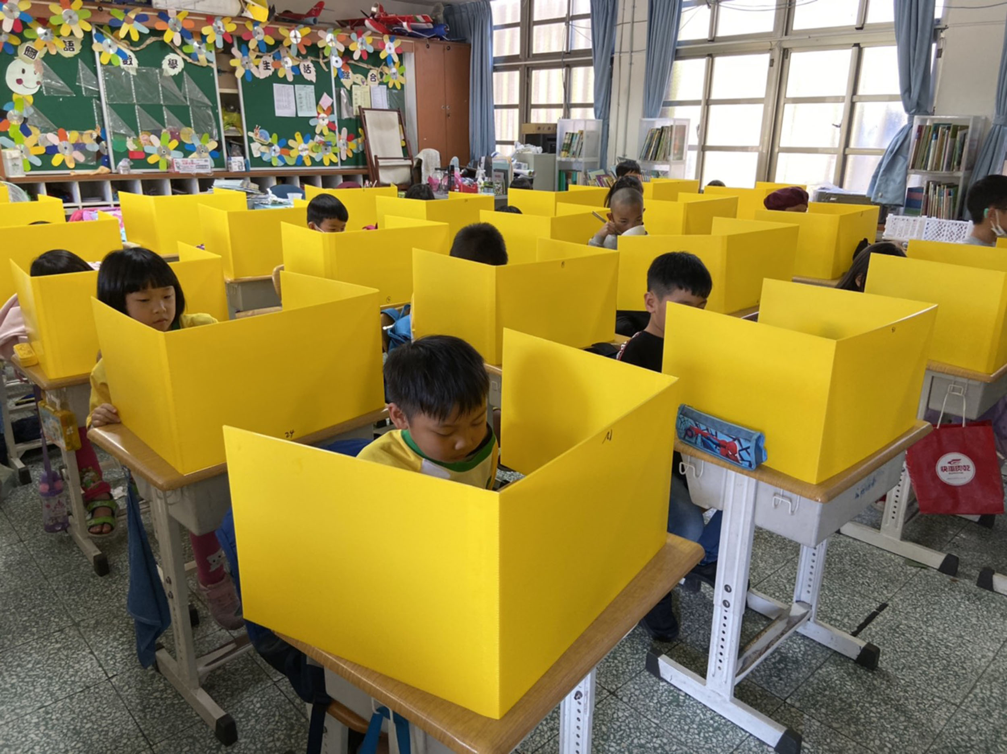

How The Pandemic Has Affected Our Children in School:
Children don’t have physical (facial and bodily) cues from their teachers and peers
Loss of social interaction time
Manifestations
  Quiet
  Anxiety
  Depression
  Stuttering and other language development issues
  ADHD indicators

Slide 15
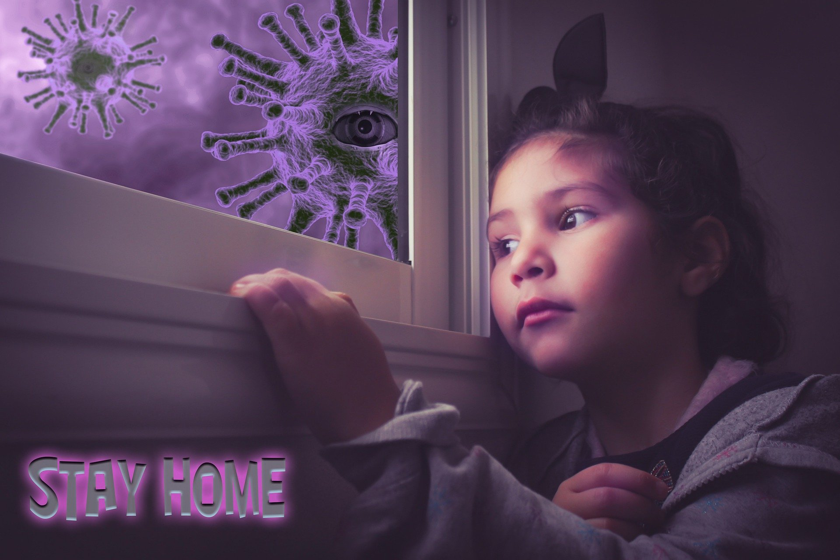
How The Pandemic Has Affected Our Children in School:
Clingy
Nightmares
School avoidance
Worry about family members
Eating changes
Increase in conflicts

Slide 16

How the Pandemic Has Affected Our Children in School:
Childcare
More screen time and social media use
Decline in physical activity
Less school referrals – less day-to-day contact with educators and other adults, signs of abuse or neglect are more likely to go unnoticed

Slide 17

How To Assist Children Cope With The Stresses and Resume a Normal Life:
  Do Activities together
  Park
  Photo albums
  Music
  Pray
  Games ( go beyond a ready-made game - invent and make a game
Do activities together…
  Talk
  Art project
  Cook, bake
  Walk
  Go to the beach

Slide 18
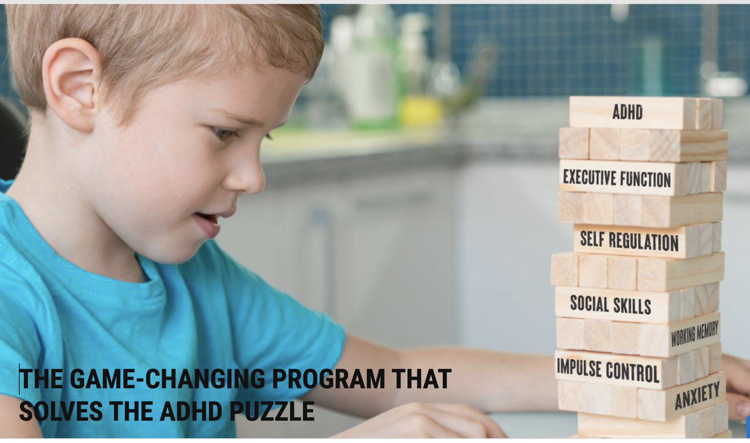
How To Assist Children Cope With The Stresses and Resume a Normal Life:
Do activities together
  Discuss self-regulation
  Provide structure
  Praise on-task behavior
  Break tasks into small steps

Slide 19
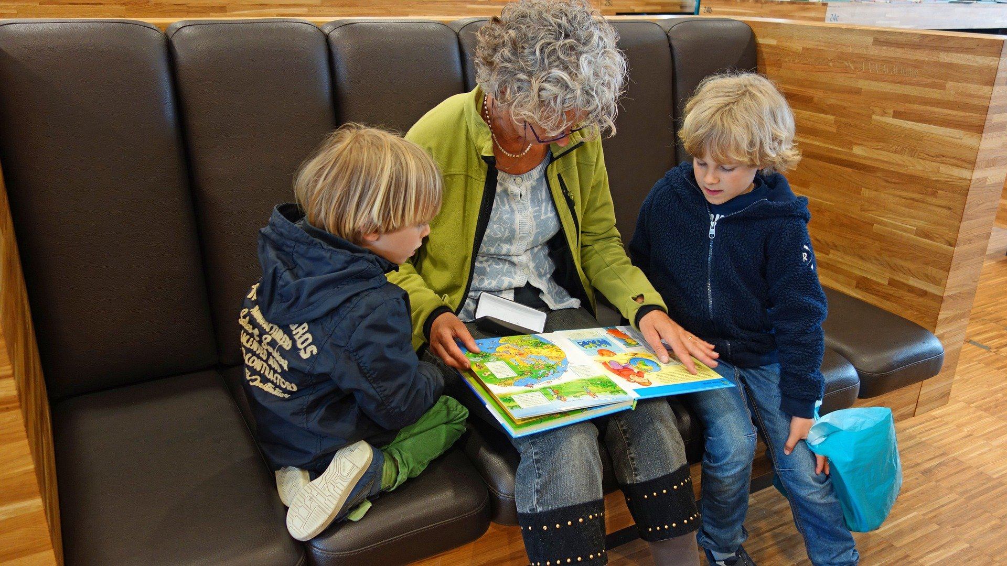
How To Assist Children Cope With The Stresses and Resume a Normal Life:
  Offer opportunities for creative thought – stories, plays, writing assignments – magazine pictures are great starters for creative writing
  Cut out cartoons and have the child lay them out in the correct sequence
  Problem solving opportunities: create, invent, discover, imagine if, predict
  Bridge lessons into real life
  Read, Read, and Read some more!

Slide 20

How To Assist Children Cope With The Stresses and Resume a Normal Life:
Maintain family routines/consistency
Monitor screen time (TV and Computer)
Inform children of anticipated familial changes
Be an active listener
Recognize distress signs
Be the example of reason and stability
Seek help from healthcare, counselors, and school personnel when flags go up

Slide 21

College Students Are Struggling Also:
Anxiety and depression are on the rise according to a new BestColleges.com survey, 95% have experienced negative mental health symptoms due to the pandemic
According to a Boston University study of 33,000 undergraduate students, 83% said that worsened mental health had negatively affected their academics
Isolation and online learning worsen the college student mental health crisis. . A study done at the University of North Carolina at Chapel Hill found that the mental health crisis among college students is associated with distanced learning and social isolation more than any other stressor, including fears over Covid-19.

Slide 22
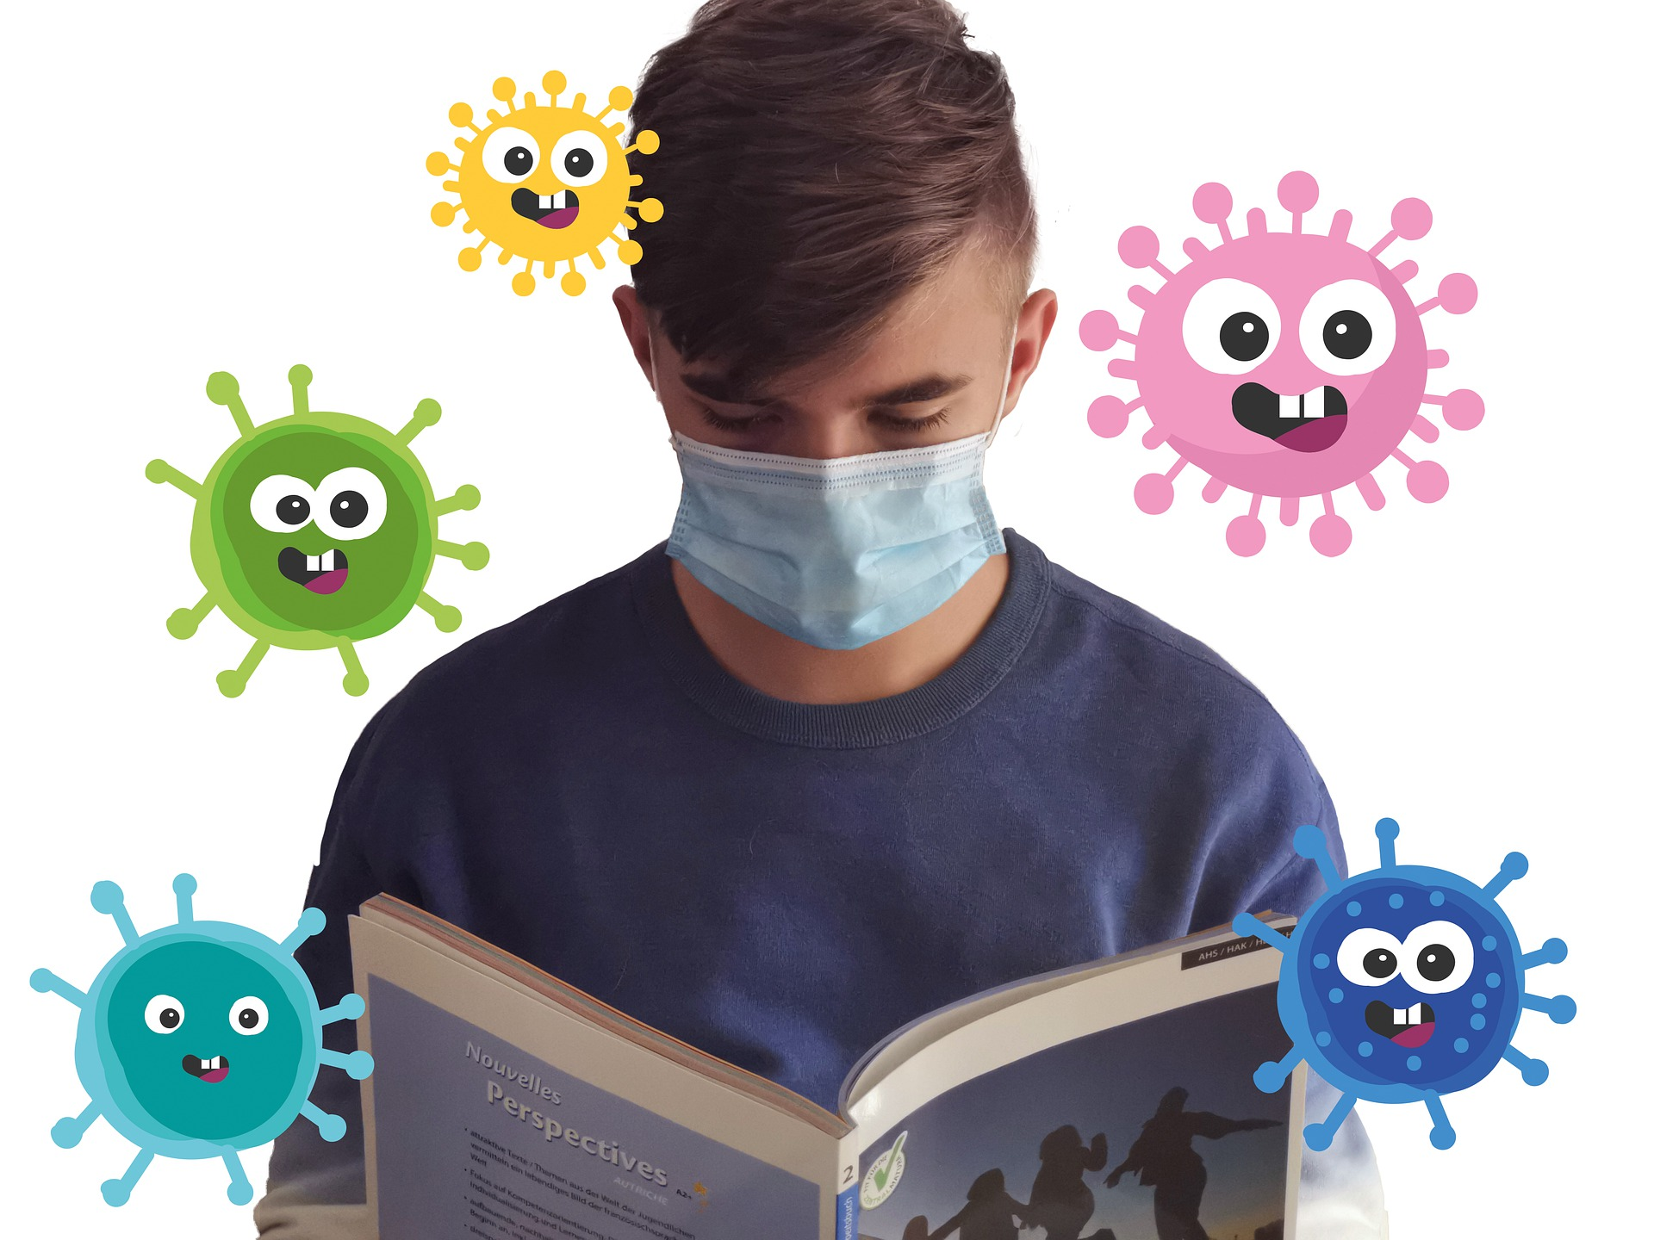
College Students Are Struggling Also:
Working out less and eating worse produce negative feedback for stressed students
Trouble concentrating, managing their time, and keeping up the momentum to graduate
Professors, administrators, school mental health practitioners may not be on campus and as readily available
College mental health and counseling centers may not be ready for the influx of needy students. Long wait times and understaffing may be issues

Slide 23

There Are Some Positives:
Renewed appreciation of their family – perhaps more Facetime with relatives
Slowed down their hectic lives
Became more reflective about values

Slide 24
LCWA Website:
www.lcwadvocacy.org

